Slide 1
Disaster preparedness and Response Education System for Schools and Colleges. (Disaster Awareness Portal)
CSE7302- University Project
Review-05
Batch Number: CSE_119
Roll Number | Student Name
20221CSE0090 | P Vishnu Vardhan
20221CSE0195 | S Vasista
20221CSE0225 | A Dhanush
Under the Supervision of,
Dr. Pamela Vinitha Eric
Professor
School of Computer Science and Engineering
Presidency University
Name of the Program: Computer Science And Engineering
Name of the HoD: Dr. Blessed Prince
Name of the Program Project Coordinator: Dr. Muthuraj
Name of the School Project Coordinators: Dr. Sampath A K , Dr. Geetha A

Slide 2
Content
Problem Statement
Objectives
Existing Methods / Drawbacks of existing methods
Architecture Diagram
Modules
Algorithms Details
Technology Stack
GitHub Link
Timeline of the Project
References

Slide 3
Problem Statement Number: SHI25008
Category : Software
Organization : Educational Institutes (Schools & Colleges)
Abstract :
The Disaster Awareness Web Application is an interactive platform designed to educate students and the general public about disaster preparedness and safety measures. The website provides structured information about actions to take before, during, and after disasters such as earthquakes, floods, and fires and etc.
The system includes interactive learning features like quizzes to test users’ knowledge and an AI-powered chatbot that answers disaster-related questions in real time. The platform is built using modern web technologies including React.js for the frontend and Node.js with Express for the backend, ensuring a responsive and user-friendly interface.
The main goal of this project is to increase disaster awareness, improve preparedness, and provide quick guidance during emergency situations through an engaging digital learning experience.

Slide 4
Objectives
Objectives:
To develop a digital platform for disaster preparedness and response education for school and college students.
To educate students on safety measures before, during, and after disasters.
To provide interactive learning modules and quizzes for better understanding and retention.
To improve student awareness through preparedness checklists and scenario-based learning.
To enable easy access to disaster safety information through a user-friendly interface.
To enhance overall disaster readiness and response capability among students.

Slide 5
Existing & Drawbacks of existing Methods
Existing Methods :
Disaster information is mainly provided through government websites, PDFs, manuals, and notices.
Awareness is created through occasional workshops, drills, or seminars in schools and colleges.
Information is mostly text-based and theoretical in nature.
Training programs are usually one-time and not continuous.
Drawbacks of Existing Methods:
Limited accessibility and low student participation.
Lack of practice-oriented learning such as quizzes or simulations.
No system to track learning progress or preparedness level of students.
Information is often complex and hard to understand for students.

Slide 6
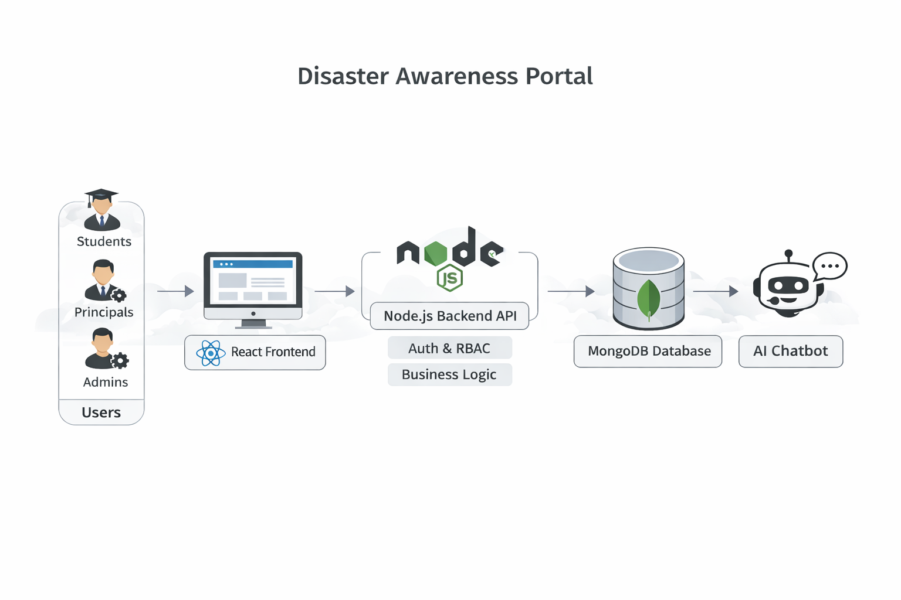
Architecture Diagram

Slide 7
Modules
User Authentication Module:
Handles user registration (Student), login and logout (Student / Admin / Principal)
Role-based access control (Student / Admin / Principal)
Secure password handling (encryption, validation)
Disaster Learning Module:
Provides structured content for disasters (Earthquake, Flood, Fire, Cyclone, etc.)
Divided into: Before ,During ,After ,Do’s and Don’ts
Supports text, images, videos
Quiz & Assessment Module:
Conducts quizzes after each module
Scenario-based and MCQ questions
Auto-evaluation and scoring
Displays results and feedback

Slide 8
Modules
AI Chatbot Assistance Module:
Provides instant answers to disaster-related queries
Helps users understand safety measures
Acts as a virtual guide during emergencies
Admin Management Module:
Add / update / delete disaster content
Manage quizzes and questions
Manage Schools and Principals
Control system data
Principal Dashboard Module:
Overview of student participation
View reports and analytics
Monitor engagement and performance
Raises Support Ticekts

Slide 9
Algorithm Details
1. JWT – Based Authentication –
Implement JSON Web Token (JWT) for secure user authentication.
Generates a token after login which verifies user identity for protected routes without storing session data.
2. Bcrypt Password hashing –
Uses bcrypt algorithm to securely hash user passwords before storing them in the database.
Protects user credentials by preventing plain text password storage and making them resistant to brute-force attacks.
3. Decision-Tree based Risk Assessment –
Implemented a decision-tree classification approach to categorize students into different risk levels.
Determines whether a student is Low Risk, Medium Risk, or High Risk based on quiz scores and preparedness indicators.
4. Role Based Access Control(RBAC) –
Different permissions are assigned to Students and Admins, ensuring secure and controlled route access.

Slide 10
Algorithm Details
5. AI-Based Response Generation (Prompt Engineering) –
Generates responses using an AI model based on disaster type and student level.
Applies structured prompts to ensure concise, safe, and relevant educational answers.
6. Ticket Management Algorithm –
Allows principals to raise support tickets for school or student issues.
Tracks ticket status (Open, In Progress, Resolved) for efficient issue handling.
7. Admin Analytics Aggregation Algorithm –
Collects and processes data such as total users, schools, and module statistics.
Generates summarized insights for admin dashboard visualization.
8. Principal Performance Analytics Algorithm –
Calculates average progress, quiz scores, and preparedness score of students.
Provides insights into overall school performance and learning effectiveness.

Slide 11
Technology Stack
Frontend:
React.js (Vite)
CSS
GSAP ( Green Sock Animation Platform) animations
Backend:
Node.js
Express.js
Database:
Mongo DB
AI:
Ollama models(local)

Slide 12
GitHub Link
“ https://github.com/vishnu090705/Disaster-awareness-Response-portal- “

Slide 13
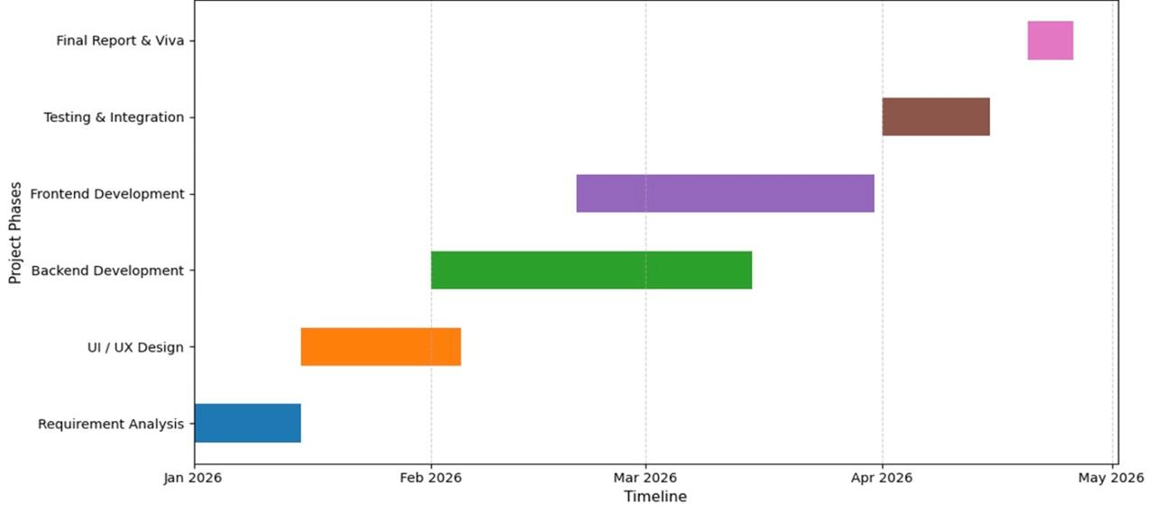
Timeline of the Project (Gantt Chart)
Disaster Awareness and Response Portal

Slide 14
References (IEEE Paper format)
[1]National Disaster Management Authority (NDMA), National Disaster Management Guidelines, Government of India, New Delhi, India, 2019. [Online]. Available: https://ndma.gov.in
[2]United Nations Office for Disaster Risk Reduction (UNDRR), Sendai Framework for Disaster Risk Reduction 2015–2030, United Nations, Geneva, Switzerland, 2015. [Online]. Available: https://www.undrr.org
[3]Ready.gov, Emergency Preparedness and Response Guidelines, U.S. Department of Homeland Security, Washington, DC, USA, 2023. [Online]. Available: https://www.ready.gov
[4]National Disaster Response Force (NDRF), Disaster Response Training and Awareness Materials, Ministry of Home Affairs, Government of India, New Delhi, India, 2022. [Online]. Available: https://ndrf.gov.in
[5]United Nations Children’s Fund (UNICEF), Disaster Risk Reduction in Education, UNICEF Publications, New York, USA, 2021. [Online]. Available: https://www.unicef.org/disaster-risk-reduction

Slide 15
References (IEEE Paper format)
[6]World Health Organization (WHO), Emergency and Disaster Preparedness Guidelines, WHO Press, Geneva, Switzerland, 2020. [Online]. Available: https://www.who.int/health-topics/emergencies
[7]Asian Disaster Preparedness Center (ADPC), Community-Based Disaster Risk Reduction Guidelines, ADPC, Bangkok, Thailand, 2019. [Online]. Available: https://www.adpc.net
[8]Federal Emergency Management Agency (FEMA), Emergency Management Training and Preparedness, U.S. Department of Homeland Security, Washington, DC, USA, 2021. [Online]. Available: https://www.fema.gov
[9]International Strategy for Disaster Reduction (ISDR), Living with Risk: A Global Review of Disaster Reduction Initiatives, United Nations, Geneva, Switzerland, 2004.
[10]International Federation of Red Cross and Red Crescent Societies (IFRC), World Disasters Report, IFRC, Geneva, Switzerland, 2020. [Online]. Available: https://www.ifrc.org

Slide 16


